Slide 1
Dev Journal
$ git push -u origin daily

Slide 2
Index
1.
2.
3.
4.
5.
6.
Statement of Purpose
User Personas
Architectural Design
Wireframes
Risks & Rabbit holes
Timeline

Slide 3
Sop Overview
Software development is a constant flow of tasks, ideas, and solutions that often become scattered and hard to retrieve. Current tools are either too complex, causing decision fatigue, or too simple, lacking integration with developer workflows like code management and prioritization. As a result, developers struggle to organize, reflect, and access critical information, wasting valuable time that could be spent on core tasks. This product provides a streamlined, developer-centered journal to solve these challenges.

Slide 4
SOP Purpose
This project aims to create a streamlined, intuitive journal for developers to document tasks, code snippets, ideas, and reflections.
With features like searchable tags, secure storage, and context-aware assistance, it bridges the gap between task, project, and code management—while keeping the simplicity of a notebook.

Slide 5
SOP Objectives
Enhance Usability: Simple, intuitive, developer-friendly UI/UX
Integrate with Developer Workflows: Code snippet storage, Git integration, Encrypted API key storage
Provide Context-Aware Assistance: Embedded notes and LLMs for real-time context-aware Q&A
Ensure Security for Sensitive Data: Encryption and secure storage protocols to store API keys & client secrets

Slide 6
User Persona #1
Background: Victor is a busy undergraduate at UC Irvine, involved in multiple computing and cultural clubs. He’s currently taking a full-stack web development course with frequent project deadlines.
Needs & Challenges:
Time Management: Juggling club events, classes, and deadlines often leads to missed meetings and cluttered reminders on his Google Calendar.
Code Organization: Victor saves code snippets and links in Google Docs but finds it disorganized and struggles with formatting issues.
Resource Management: Important articles and documentation get lost due to inconsistent file naming.
Progress Tracking: Victor wants to improve as a programmer but often forgets to journal his daily progress and goals.
Goal: Victor needs an efficient, all-in-one tool to stay organized, manage his code and resources, and track personal progress.

Slide 7
User Persona #2
Background: Stephanie is a first-year PhD student at UC Santa Barbara in Computer Science & Engineering, transitioning from an Electrical Engineering background. She's balancing classes, two research projects, and managing a capstone team.
Needs & Challenges:
Time Management: She is often overbooked and has limited time to explore new programming tools.
Organization: Her notes, ideas, and meeting takeaways are scattered across various digital platforms and physical notebooks, making retrieval difficult.
Work-Life Balance: Stephanie is committed to not working after 6 p.m. or on weekends but wants to allocate time for exploring new areas in computer science.
Goal: Stephanie needs a streamlined solution to quickly capture, organize, and retrieve her insights, ideas, and notes efficiently during her work hours

Slide 8
User Persona #3
Background: Ram is a software engineer at a major tech company, balancing a busy social life with a desire to excel at work. He’s currently managing a complex project with numerous components, from dropdowns to routing, while planning adventures on the side.
Needs & Challenges:
Focus and Recall: Ram struggles with remembering technical details and project learnings amid distractions and his active lifestyle.
Knowledge Tracking: He wants an organized way to record code summaries, logic explanations, and important decisions for easy reference.
Skill Growth: Ram aims to become a high-impact developer, keeping up with new frameworks and best practices.
Goal: Ram needs a Developer Journal to capture his technical knowledge, track project insights, and organize key learnings. This would help him stay prepared for updates, improve his skills, and achieve his "10x Developer" goal.

Slide 9
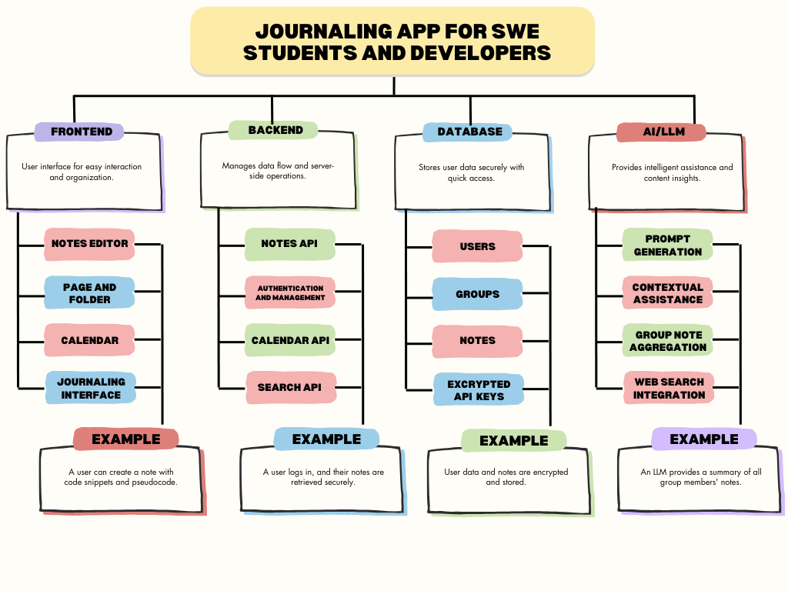
ARCHITECTURE

Slide 10
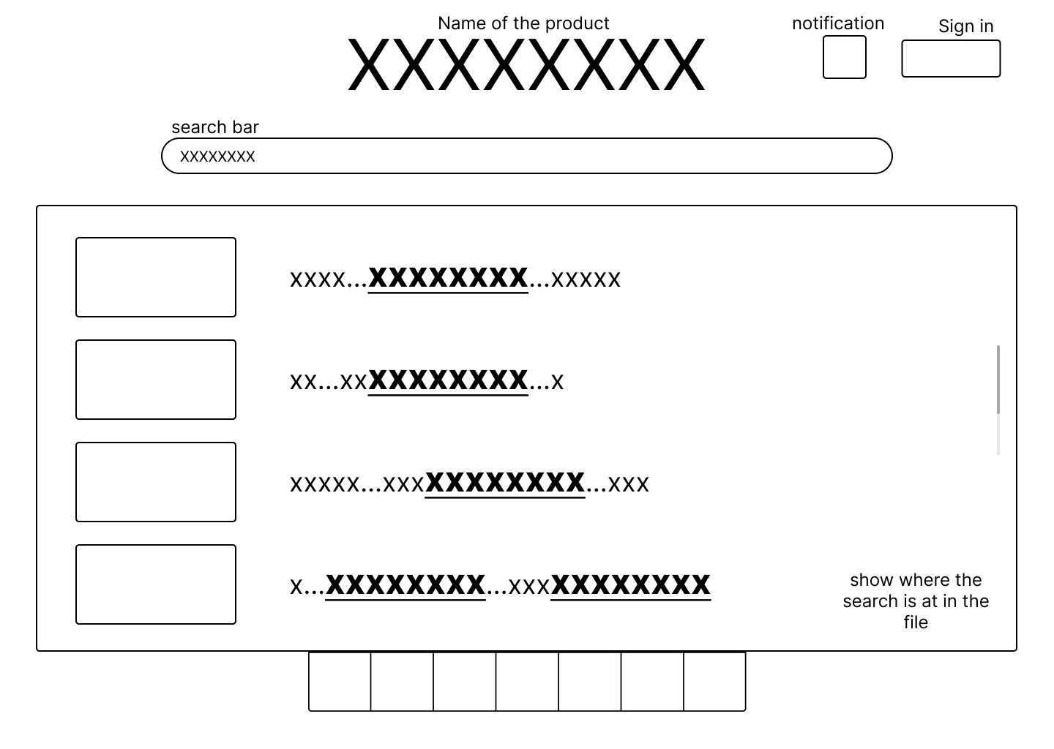
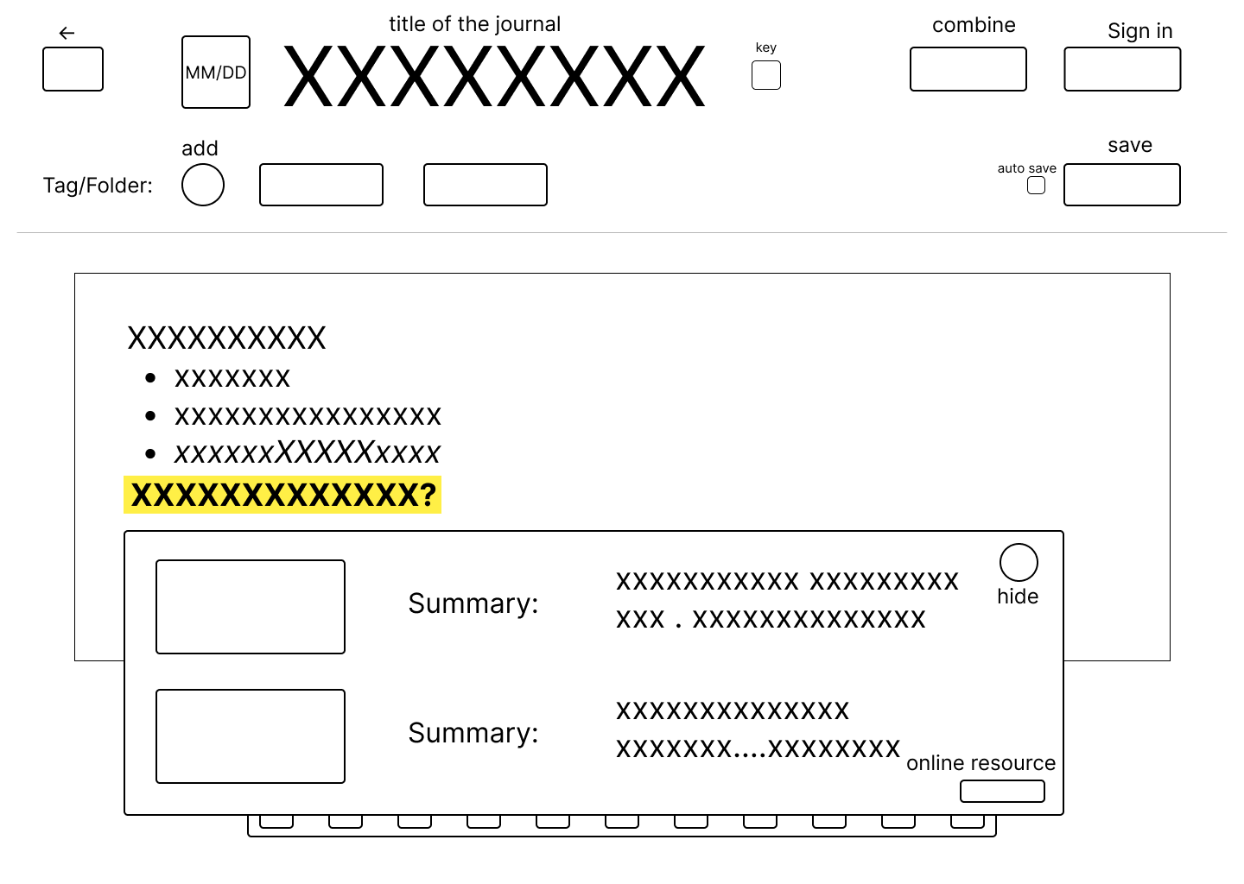
wireframes
https://www.figma.com/design/L1MOeEt8DEzjTw2N4M5UO5/Untitled?node-id=9-1950&node-type=frame&t=GciCVut0z7ChTLYm-0

Slide 11
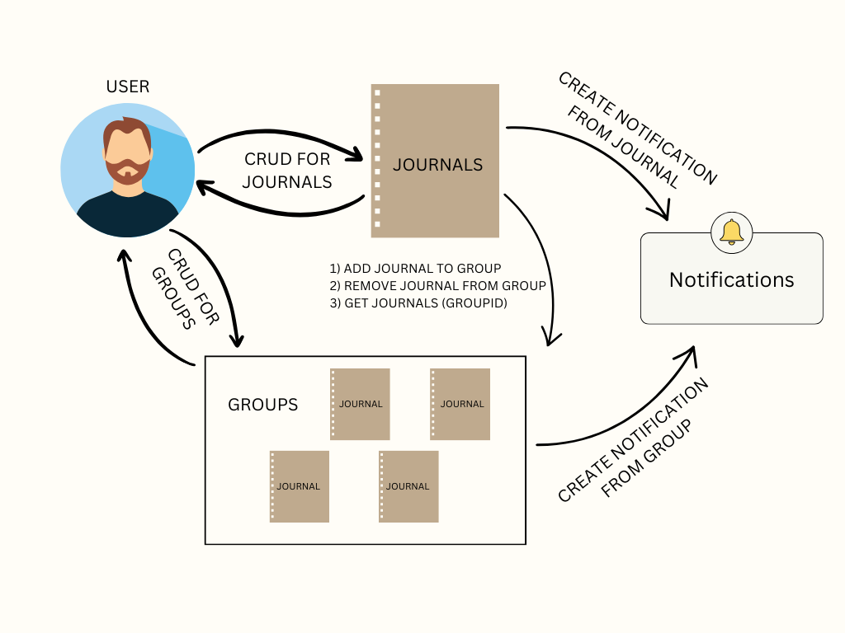
FLOWCHART

Slide 12
RISKS
Adoption Risk: Developers may be reluctant to add another tool to their already crowded toolset.
Mitigation: Prioritize a simple, intuitive interface to minimize the learning curve and ensure the first version is easy to use, providing higher-quality entries than a standard text editor.
Privacy and Trust Concerns: Users may feel uncomfortable sharing personal notes if privacy isn't ensured.
Mitigation: Implement separate access controls for personal vs. shared content, anonymize data where appropriate, and limit cloud-shared data.
Accessibility and Flexibility: Users may need access on mobile or outside of high-speed desktop environments.
Mitigation: Enable essential functions offline using caching/local storage to support work on mobile and lower-speed devices.

Slide 13
RABBIT HOLES
Minimal Text Options: Limit to basic formatting (bold, italics, underline) to reduce user decision fatigue and keep note-taking fast.
Avoid Calendar Features: Use simple date tracking instead of a calendar to keep another tool focused on quick note-taking, not task organization.
Low Configurability: Keep the tool straightforward, like a pen and paper, without extensive customization options.
Functional UI Over Design: Prioritize usability over aesthetic appeal given the limited timeframe.
No Cloud Storage: Store notes locally as files (e.g.,.txt, .json) to reduce security risks and simplify data handling.

Slide 14
TIMELINE
Week #1 - Finalizing ADRs and figma UI/UX
Week #2 - Core feature implementation
Week #3 - Additional features & basic CI/CD
Week #4 - Styling and design
Week #5 - Testing & final CI/CD

Slide 15
Thank you.

